Slide 1
SCSA SC2001 Lab
Example Class
Project 3 Team 7
PU FANYI (U2220175K)
PUSHPARAJAN ROSHINI (U2222546A)
QIAN JIANHENG OSCAR (U2220109K)
RHEA SUSAN GEORGE (U2220116B)

Slide 2
2 Recursive Definitions
Naive Approach
Optimised Approach
#1 Improved optimised approach - 2 column
#2 Further improved optimised approach - 1 column
Notes:
While doing this project, we came up with 2 approaches. One naive approach and another optimised approach

Slide 3
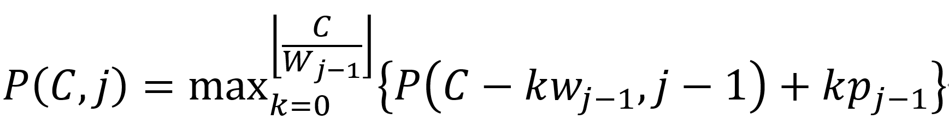
Recursive Definition: Naive Approach
Remaining capacity for sub problem
Sub-problem:
If don’t (j-1)-th item
Capacity
Number of (j-1)-th item we take
Types of items
range of k
Base Case: P(C,0) = 0
Notes:
In the naive recursive approach to the Unbounded Knapsack Problem:
1. Base Case: when j is zero, no items can be added.
2. Recursive Case: For a knapsack with capacity C, you recursively consider each item j-1, then we enumerate k for how many items we can choose for item j-1, so until weight of j-1 * k is more than Capacity.
3. Maximization: We will take the max of each k
4. Inefficiency: This method repeats calculations for the same capacities many times, which makes it very slow for large capacities or many items.
The process is repeated until all combinations of items and capacities have been considered. The result of P(C) is the maximum profit that can be obtained with a knapsack of capacity C.

Slide 4
Subproblem Graph: Naive Approach
P(0, 0) = 0 | P(0, 1) = 0
P(2, 0) = 0 | P(2, 1) = 0
P(4, 0) = 0
P(6, 0) = 0 | P(6, 1) = 7 | P(6, 2) = 7
P(8, 0) = 0 | P(8, 1) = 14
P(10, 0) = 0
P(14, 0) = 0 | P(14, 1) = 21 | P(14, 2) = 21 | P(14, 3) = 21
Notes:
Optimised → 2 arrows, and the nth value for picking same object again is the same
Script: This is the subproblem graph of the naive approach.

Slide 5
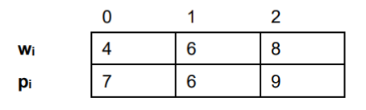
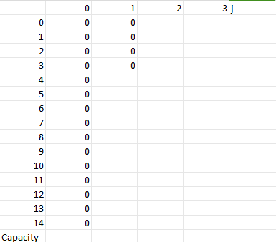
Example
7
C = 4
W_{j-1} = 4
k = 4/4 = 1 → k stops at 1
k=0,
P(4, 0) = 0
k=1,
P(0,0) + 1*7 = 7
Notes:
So here is an example of running this algo. The first column means we dont take any item, which naturally means profit is 0.
Then lets say we want to calculate the profit for take 1 item, then we will compare to P(4,0), and then take P(0,0) plus 1*7. Then we obtain the max profit to be 7.

Slide 6
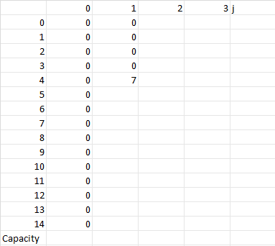
Example
C = 5
W_{j-1} = 4
k = 5/4 = 1 → k stops at 1
7
k=0,
P(5, 0) = 0
k=1,
P(1,0) + 1*7 = 7
Notes:
Similarly, for capacity of 5 and taking only 1st item, we compare P(5,0) and P(1,0) + 1*7. Where the max is 7

Slide 7
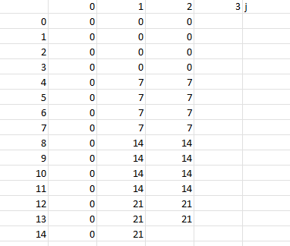
Example
C = 14
W_{j-1} = 6
k = floor(14/6) = 2 → k stops at 2
k=0,
P(14, 1) = 21
21
k=1,
P(8, 1) + 1*6 = 19
k=2,
P(2, 1) + 2*6 = 12
Notes:
Another example here is that we want to calculate for capacity 14 and take 1st and 2nd item.
So we will iterate through until k*weight of 2nd item is more than capacity.
Then we take the max, which is 21 here

Slide 8
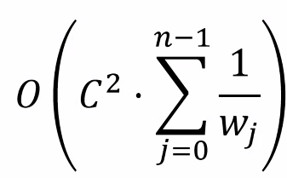

Complexity: Naive Approach
Average Time Complexity:
Worst time complexity: when w_{j} = 1
for c in range(C): # O(C)
for j in range(n): # O(n)
for k in range(C / w[j - 1]): # O(C/W_{j-1})
# Calculate P(C, j)
Notes:
For the average time complexity, we can see that there are 3 for loops. So, the time complexity is actually the big O of C * summation of inner loop which is summation of C/wj. Then here we move the C out of summation to get O(c^2 * summation of 1/wj)
The worse case occurs when wj = 1, then the worst case time complexity = O(C^2 * n)
So actually we can see that this method is not very optimal

Slide 9
Code for Naive Approach
int knapsack(const Item *items_begin, const Item *items_end, const int capacity) {
size_t len = items_end - items_begin;
int **f = calloc(len + 1, sizeof(int *));
for (int i = 0; i <= len; ++i) {
f[i] = calloc(capacity + 1, sizeof(int));
memset(f[i], 0, (capacity + 1) * sizeof(int));
}
for (int i = 1; i <= len; ++i) {
for (int j = 0; j <= capacity; ++j) {
for (int k = 0; k * items_begin[i - 1].weight <= j; ++k) {
f[i][j] = max(f[i][j],
f[i - 1][j - k * items_begin[i - 1].weight] +
k * items_begin[i - 1].profit);
}
}
}
int ans = f[len][capacity];
free(f);
return ans;
}
Notes:
This is the code for our naive approach. Can see that we utilises 3 for loops here

Slide 10
Recursive Definition: Optimised Approach
Don’t choose jth element
Choose jth element
Reserve w_{j} capacity for the item
Base Case: P(C,0) = 0
You can still choose item j due to unlimited supplies
Notes:
Here, we consider a more optimised approach where we only compare the case where we dont choose jth element and choose jth element. So each time, we only look at 2 sub problems. We can do this because we know that the sub problems are always optimal

Slide 11
Subproblem Graph : Optimised Approach
P(0, 0) = 0 | P(0, 1) = 0 | P(0, 2) = 0
P(2, 0) = 0 | P(2, 1) = 0 | P(2, 2) = 0
P(4, 0) = 0 | P(4, 1) = 7
P(6, 0) = 0 | P(6, 1) = 7 | P(6, 2) = 7 | P(6, 3) = 7
P(8, 0) = 0 | P(8, 1) = 14 | P(8, 2) = 14
P(10, 0) = 0 | P(10, 0) = 14
P(14, 0) = 0 | P(14, 1) = 21 | P(14, 2) = 21 | P(14, 3) = 21
Notes:
This is the sub problem graph of the optimised approach. We can see that each problem only arrows out to 2 sub problems

Slide 12
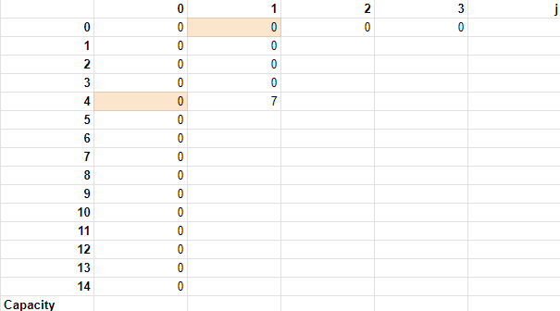
Example
P(4,1) = max((P(4,0), P(4-4,1) + 7)
= max((P(4,0), P(0,1) + 7)
= max(0,7)
= 7
Notes:
S here is an example of running this algo. Lets say we want to calculate for capacity = 4 and take only 1st item. Then we will take take the max of p(4,0) and P(4,1) + Weight of 1st item which is 7. So we get 7

Slide 13
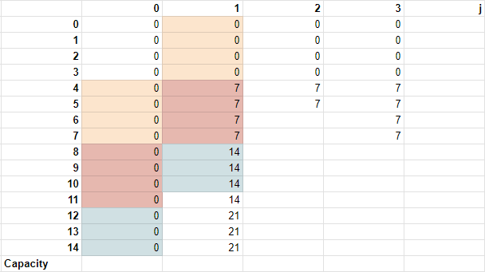
Example
P(12,1) = max((P(12,0), P(12-4,1) + 7)
= max((P(12,0), P(8,1) + 7)
= max(0,21)
= 21
Wj < C
Notice the pattern!

Slide 14
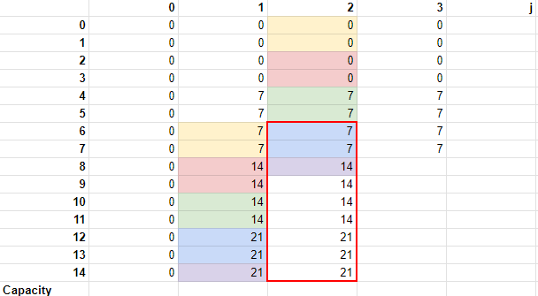
Example
P(11,2) = max((P(11,1), P(11-6,2) + 6)
= max((P(11,1), P(5,2) + 6)
= max(14,13)
= 14
MAX(14,13)

Slide 15
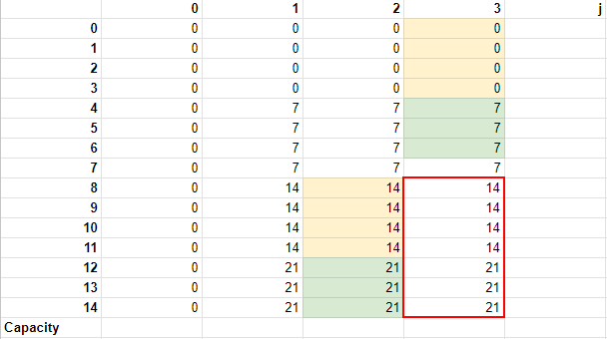
Example
Object 0 costs lesser weight + profit-friendly
Example : 2 times of Object 0 is >> 1 Object 2
P(8,3) = max((P(8,2), P(8-8,3) + 9)
= max((P(8,2), P(0,3) + 9)
= max(14,9)
= 14
P(14,3) = max((P(14,2), P(14-8,3) + 9)
= max((P(14,2), P(6,3) + 9)
= max(21,15)
= 21
Notes:
Comment about the weights and profits

Slide 16
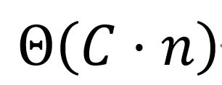
Complexity : Optimised Approach
for c in range(C + 1): # O(C)
for j in range(n): # O(n)
# O(1) calculate P(c, j)
Notes:
For the time complexity of this optimised approach, since there is only 2 for loops, then the time complexity will be Big theta (C * n). This is significantly better than the naive approach

Slide 17
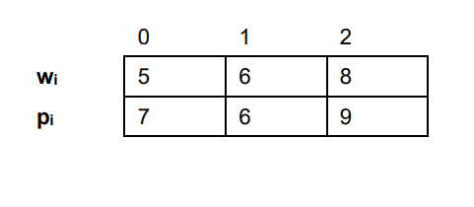
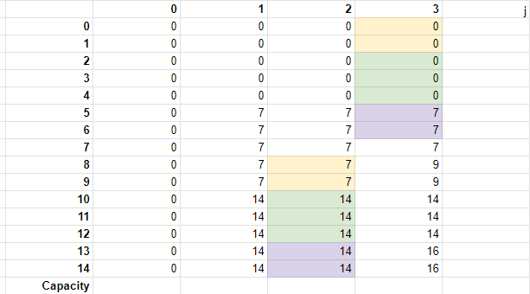
Running result for
Maximum Profit = 16
Notes:
Quick trick : 0th object cost lesser weight, but more profit so actually 1st object isnt that useful so it will rely on profit of 1st object - values of 1st object will be same as 0th column, 3rd object will have some variation cos

Slide 18
Code for Optimised Approach
int knapsack(const Item *items_begin, const Item *items_end, const int capacity) {
int **f = calloc((items_end - items_begin + 1), sizeof(int *));
for (int i = 0; i <= items_end - items_begin; ++i) {
f[i] = calloc(capacity + 1, sizeof(int));
}
memset(f[0], 0, (capacity + 1) * sizeof(int));
for (const Item *item = items_begin; item != items_end; ++item) {
for (int i = 0; i <= capacity; ++i) {
if (i >= item->weight) {
f[item - items_begin + 1][i] = max(f[item - items_begin][i],
f[item - items_begin + 1][i - item->weight] + item->profit);
} else {
f[item - items_begin + 1][i] = f[item - items_begin][i];
}
}
}
int ans = f[items_end - items_begin][capacity];
for (int i = 0; i <= items_end - items_begin; ++i) {
free(f[i]);
}
free(f);
return ans;
}

Slide 19
Analysis of both approaches
Time Complexity for Optimised Approach is better than Naive
O(Cn) << O(C²n)

Slide 20
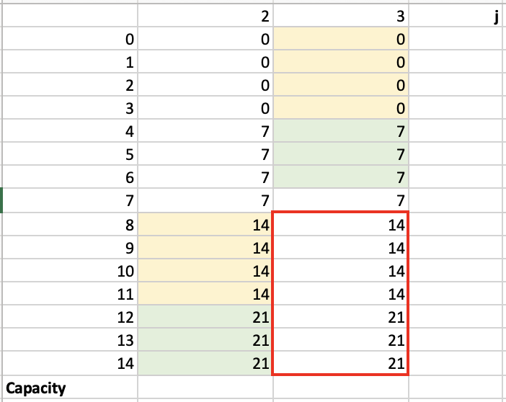
Improved optimised approach : 2 columns + 1 column
Notes:
Instead of maintaining a large table, maintain only the relevant columns or rows necessary for the computation. For instance, in a 2D DP array shown above, you could reduce the space by keeping two arrays: one for the current state and one for the previous state. After computing the current state, swap the previous state with the current one. This way, you only ever have two states in memory at any time.
So we can further improve the space complexity this way

Slide 21
Notes:
As shown above, the two columns are selected and how the values are overridden is shown by

Slide 36
Saves space!
Improves space complexity

Slide 37
Notes:
Building upon this idea, we further improve on the space complexity by just using 1 column of array.

Slide 38
Notes:
As you iterate through each row, you update the 1D array in-place. For each new element in the row, you calculate its value based on the current value in the 1D array and the previous value you just overwrote. Use a variable to keep track of the value that was just overwritten in the 1D array. Update this variable as you move across the columns.

Slide 50
Saves space!
Improves space complexity

Slide 51
Final Approach
int knapsack(const Item *items_begin, const Item *items_end,
const int capacity) {
int *f = calloc(capacity + 1, sizeof(int));
memset(f, 0, (capacity + 1) * sizeof(int));
for (const Item *item = items_begin; item != items_end; ++item) {
for (int i = item->weight; i <= capacity; ++i) {
f[i] = max(f[i], f[i - item->weight] + item->profit);
}
}
int ans = f[capacity];
return ans;
}

Slide 52
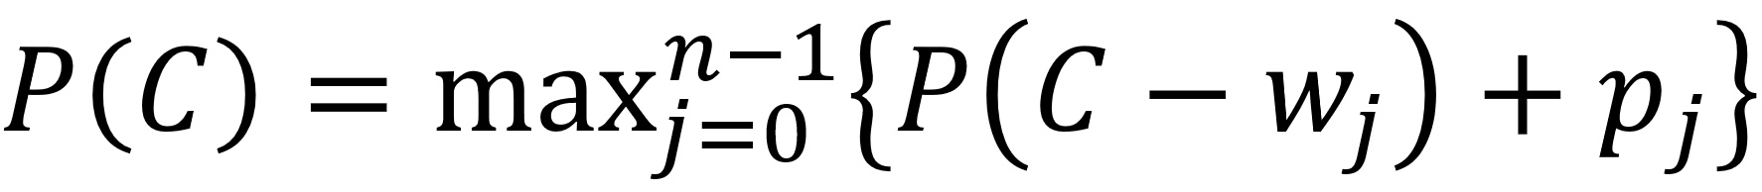
Looking closely
int knapsack(const Item *items_begin, const Item *items_end,
const int capacity) {
int *f = calloc(capacity + 1, sizeof(int));
memset(f, 0, (capacity + 1) * sizeof(int));
for (const Item *item = items_begin; item != items_end; ++item) {
for (int i = item->weight; i <= capacity; ++i) {
f[i] = max(f[i], f[i - item->weight] + item->profit);
}
}
int ans = f[capacity];
return ans;
}
Choose j^{th} element
P(14)
P(13)
P(12)
P(11)
P(10)
P(9)
P(8)
P(7)
P(6)
P(5)
P(4)
P(3)
P(2)
P(1)
P(0)
Notes:
When we examine this code closely, we find a new way of understanding it. For example, for P(11), we realize that P(11) is transitioned from P(7), P(5), and P(3). This means that now I have a knapsack of capacity 11, and I need to choose one item to put into it. This is how we arrive at this new expression.

